Slide 1
Emerging Issues in Government Accounting
& Auditing
Rutgers Governmental A&A
Update Conference
November 29, 2018

Slide 2
Today’s Agenda
State Fiscal Outlook
Legislative and Regulatory Issues
Uniform Guidance Implementation
Accounting and Auditing Issues
Other Emerging Issues

Slide 3

Do You Ever Feel Like This?

Slide 4
State Fiscal Outlook

Slide 5
NATIONAL OVERVIEW
GDP growth:
2.3% in 2017 compared to 1.5% in 2016 (lowest since 2011)
2.7% est. in 2018
2.4% forecast for 2019
Stock Market:
2016 – DJIA up 13.5%
2017 – DJIA up 24%
2018 – DJIA up 6.6% through 3rd quarter
Recession:
WSJ panel of economists predict 18% probability of recession in next 12 months (July 2018); the highest level since October 2016.
Unemployment:
3.7% in October 2018 (lowest level since December 1969)
Wage and salary growth:
3.1% overall annual increase in 3rd qtr. 2018
Jobs:
October 2018 – 250,000 (97th straight month of positive job creation)
2017 – 181,000
2016 – 195,000
Interest rates:
Fed Reserve raised rates .25% in September 2018. Eighth increase since the Great Recession.
Source: Wall Street Journal

Slide 6
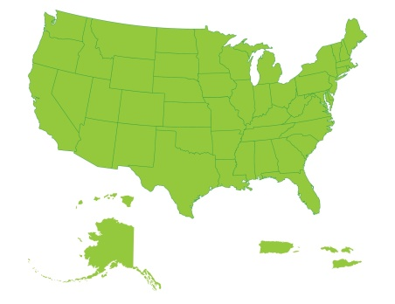
STATE OVERVIEW
Governors’ budgets for fiscal 2019 recommend a general fund spending increase of 3.2 percent, as fiscal conditions have improved compared to this time last year.
Revenue growth picked up in fiscal 2018 after 2 years of weakness, and is estimated at 4.9 percent, though growth varies by state and the median is lower at 2.7 percent.
Only 9 states have had to make mid-year budget cuts, and 47 states reported meeting or exceeding budgeted revenue projections for fiscal 2018.
Governors proposed mostly modest tax changes for fiscal 2019, some in response to the new federal tax law, with a net revenue impact of +$2.8 billion.
Most states continue to strengthen their rainy day funds, with the forecasted median balance as a share of general fund spending rising to 6.2 percent in fiscal 2019, from a recent low of 1.9 percent in fiscal 2011.
Medicaid spending is projected to slow in fiscal 2019, with a median growth rate of 1.9 percent from all funds (1.5 percent state funds), but the program continues to pose spending pressures over the long term.
Source: NASBO Spring 2018 Fiscal Survey

Slide 7
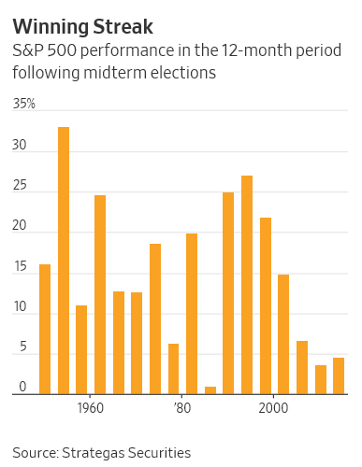
Midterms Are a Boon for Stocks—No Matter Who Wins
The year after the midterms has historically been the best of the four-year cycle for stocks
  The S&P 500 hasn’t declined in the year after midterm elections since the 1946 cycle and has climbed 15% on average regardless of which party won or lost control of Congress
  In comparison, the average annual gain in every year going back to 1946 is 8.8%, and it has slumped in 20 of those years, according to Dow Jones Market Data.

Slide 8
GENERAL FUND SPENDING TRENDS & RECOMMENDED BUDGETS FOR FISCAL 2019

Slide 9
FISCAL 2018 GENERAL FUND SPENDING
SLIGHTLY EXCEEDS INFLATION-ADJUSTED PRE-RECESSION PEAK
General Fund Spending: FY 2008 – FY 2019
Source: NASBO Fiscal Survey of States; Fiscal 2019 figure is based on governors’ recommended budgets.
*Aggregate spending level needed to total at least $832 billion in fiscal 2018 to be equivalent with or exceed real 2008 spending level.

Slide 10
STATE GENERAL FUND SPENDING EXPECTED TO SEE MODEST INCREASE IN FISCAL 2019
Annual General Fund Expenditure Growth (%)
*Average
*40-year historical average annual rate of growth is 5.4 percent .
**Fiscal 2019 percentage growth is based on recommended budgets (and enacted budgets for some biennial states that passed two-year budgets in 2017). Median growth rate for fiscal 2019 is 2.7 percent.
Source: NASBO Fiscal Survey of States

Slide 11
TOTAL STATE EXPENDITURES
BY FUND SOURCE
FISCAL YEAR 2018
$2.032 Trillion
Source: NASBO State Expenditure Report – November 2018

Slide 12
TOTAL STATE EXPENDITURES BY FUNCTION
ESTIMATED FISCAL 2018
Source: NASBO State Expenditure Report – November 2018

Slide 13
TOTAL STATE EXPENDITURES PERCENTAGE SPENDING GROWTH
BY PROGRAM AREA
FISCAL 2017
ESTIMATED FISCAL 2018
*Total state expenditures include spending from general funds, other state funds, bonds, and federal funds to states
Source: NASBO State Expenditure Report – November 2018

Slide 14
ONLY 9 STATES MADE MID-YEAR BUDGET CUTS IN FISCAL 2018, TOTALING $830 MILLION
Budget Cuts Made After the Budget Passed
Recession ends
Recession ends
Recession ends
Source: NASBO Fiscal Survey of States

Slide 15
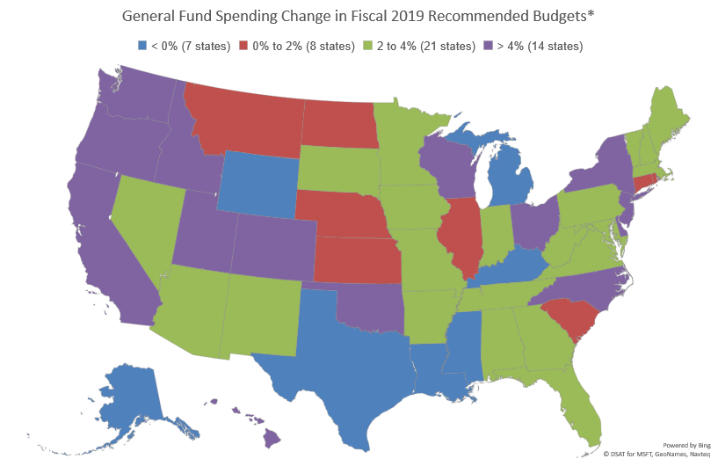
MOST GOVERNORS PROPOSE MODERATE SPENDING GROWTH IN FISCAL 2019, AN IMPROVEMENT OVER LAST YEAR
* Compared to estimated fiscal 2018 spending levels. Source: NASBO Fiscal Survey of States

Slide 16
GENERAL FUND REVENUE

Slide 17
REVENUE GROWTH ACCELERATES IN FISCAL 2018 AFTER TWO YEARS OF WEAKNESS
Governor’s Budgets - Modest Growth Expected in Fiscal 2019
General Fund Revenue: FY 2008-FY 2019
+2.1%
+6.2%
+2.5%
+1.8%
Source: NASBO Fiscal Survey of States; Fiscal 2019 figure is based on recommended budgets. The median estimated growth rate for fiscal 2018 is 2.7 percent; the median projected growth rate for fiscal 2019 is 2.8 percent.
*Aggregate revenue level needed to total at least $823 billion in fiscal 2018 to be equivalent with or exceed real 2008 spending level.

Slide 18
VAST MAJORITY OF STATES MET OR EXCEEDED REVENUE PROJECTIONS FOR FISCAL 2018
General Fund Revenue Collections Compared to Original Budget Projections
Source: NASBO Fiscal Survey of States.

Slide 19
REVENUE GROWTH BY PERCENTAGE
STATE GENERAL FUNDS
Fiscal 2017 Estimated Fiscal 2018
Source: NASBO State Expenditure Report – November 2018

Slide 20
STATE SAVINGS ACCOUNTS
(RAINY DAY FUNDS)

Slide 21
MEDIAN RAINY DAY FUND LEVEL EXCEEDS PRE-RECESSION PEAK, CONTINUES TO RISE
Median Rainy Day Fund Balance Over Time
6.5%
Source: NASBO Fiscal Survey of States 13 states are under 3% in 2018

Slide 22
FEDERAL OUTLOOK FOR STATES

Slide 23
FEDERAL UNCERTAINTY FOR STATES
THIS TIME LAST YEAR
The Affordable Care Act, especially Medicaid – Per capita caps, Block Grants, Expansion
Tax Policy Considerations – municipal debt, border-adjusted corporate tax, state/local tax deductibility
The Fiscal 2018 Budget
Infrastructure

Slide 24
FEDERAL UNCERTAINTY FOR STATES
EARLY 2018
The Affordable Care Act, especially Medicaid – Per capita caps, Block Grants, Expansion
Tax Policy Considerations – municipal debt, border-adjusted corporate tax, state/local tax deductibility
The Fiscal 2018 Budget
The Fiscal 2019 Budget -March 23, 2018
Infrastructure – a “good” uncertainty

Slide 25
WHAT DOES THIS MEAN?

Slide 26
WHAT DOES THIS MEAN FOR YOU?
Better revenue situation for FY 2018 and 2019 than last two years.
Revenue uncertainty with federal tax law changes-tax policy in mix.
Mixture of tight labor market sectors and minimal pay increases
Pension costs growing share and K-12 priority remains
Federal funding in the short-run is not much of a threat.

Slide 27
Legislative and Regulatory Issues

Slide 28
Key Tax Issues
Online Sales Taxes
  South Dakota vs. Wayfair
The Tax Cuts and Jobs Act of 2017
  P.L. 115-97
  Signed into law December 22, 2017
  Most significant changes to the IRC in 30 years
  Several key impacts on S&L governments

Slide 29
South Dakota v. Wayfair
U.S. Supreme Court overturned 1992 Quill v. North Dakota on June 21, 2018
  Allows state and local governments to require retailers with no in-state presence to collect sales taxes
  Physical presence in state no longer needed
Impact:
  GAO report (December 2017) estimates that states lost $8 billion to $13 billion in sales tax revenue in 2017 which is a 2 to 4% increase
  eCommerce sales in 2005 were $87 billion compared to $225.5 billion in 2012 (Dept. of Commerce)
    Estimated to be $462 billion in 2018

Slide 30
South Dakota v. Wayfair
What’s next?
  States will need to get businesses to register under their systems and release rules and technical guidance
    14 states are collecting effective October 1, 2018
    Another wave of states is expected on January 1, 2019
  Possible legislation
    The Remote Transactions Parity Act (HR 2193)
    Marketplace Fairness Act (S. 976)
      Introduced April 27, 2017 but stalled
    Stop Taxing Our Potential (STOP) Act of 2018 (S. 1320)
      Introduced on June 28, 2018
    Some prefer a legislative solution for consistency

Slide 31
Tax Cuts and Jobs Act of 2017
Potential impacts – S&L governments:
  Will depend on how each state conforms to the new IRC. For example,
    20 states are automatic, 19 states pick specific date
    30 tie to AGI, 6 to taxable income
    24 tie to either the number of exemptions or the $
    10 require same deduction on state return as on Fed
    6 states tie to new pass-through deduction

Slide 32
Tax Cuts and Jobs Act of 2017
What are states going to do?
  Will automatic states change to fixed date?
  Many are looking to avoid inadvertent tax increases
  Break tie to number of federal personal exemptions – MI, MD, NE, NY
  Relax mandatory use of matching federal return’s choice of itemized or standard deduction
  Less conformity without increasing complexity

Slide 33
Tax Cuts and Jobs Act of 2017
What did states do in 2018 sessions?
  28 states took some actions:
  AZ, AR, CT, FL, GA, HI, ID, IL, IN, IA, KY, MD, MI, MO, NE, NY, NC, NJ, OH, OK, OR, SD, TN, UT, VA, VT, WV, WI
  16 states did not or haven’t yet:
  AL, CA, CO, DE, KS, LA, MA, ME, MN, MS, MT, NM, ND, PA, RI, SC
  KS-tie vote in House, MN-Gov vetoed, ME-special session, MT, ND-no session
  6 states = NA: AK, NH, NV, TX, WA, WY

Slide 34
Tax Cuts and Jobs Act of 2017
Impact on municipal bonds
  The good news:
    Interest remains tax-exempt
    Private activity bonds were left unchanged
      Initial House version eliminated exemption
  The bad news:
    Advance refunding has been eliminated
    Tax credit bonds have been repealed
      Qualified school construction bonds (QSCB)
      Qualified zone academy bonds (QZAB)
      Clean renewable energy bonds (CREB)

Slide 35
Municipal Disclosures – SEC Proposes and Finalizes Amendments to Rule 15c2-12
Proposal issued on March 1, 2017
  Improves investor protection and enhances transparency in municipal securities market
    Addresses concern about private bank lending
Adds two new event notices under continuing disclosure undertakings
  Currently there are 14 listed events
  Requires notice within 10 days of the occurrence
Final Rule issued on August 31, 2018
Dates
  Effective Date: October 30, 2018
  Compliance Date: February 27, 2019

Slide 36
Municipal Disclosures –Amendments to Rule 15c2-12
Two new events are:
  Incurrence of a financial obligation of the issuer or obligated person, if material, or agreement to covenants, events of default, remedies, priority rights, or other similar terms of a financial obligation, any of which affect security holders, if material
  Default, event of acceleration, termination event, modification of terms, or other similar events under the terms of the financial obligation of the issuer or obligated person, any of which reflect financial difficulties

Slide 37
Municipal Disclosures –Amendments to Rule 15c2-12
“Financial Obligation” is defined as:
  A debt obligation (e.g., bank loans, capital leases)
  Derivative instrument, or a
  Guarantee of either of the above
Final Rule does not include in the definition of “financial obligations”
  Operating leases
  Monetary obligation resulting from a judicial, administrative, or arbitration proceeding
Materiality also not defined in the Final Rule.

Slide 38
Municipal Disclosures –Amendments to Rule 15c2-12
What should be disclosed?
  A description of the material terms of the financial obligation, including:
    Date of incurrence
    Principal amount
    Maturity and amortization
    Interest rate (or method of computation of the interest rate)
    Default rates

Slide 39
Economic Growth, Regulatory Relief, and Consumer Protection Act
SB 2125
  Signed into law by President on May 24, 2018
Two key provisions:
  Treats municipal securities as 2B liquid assets
  Maintains funding for GASB as provided in section 978 of Dodd-Frank Act

Slide 40
OMB Uniform Guidance

Slide 41
Uniform Guidance Implementation – Current Developments
OMB issued latest round of FAQs in July 2017
  24 new FAQs bringing total to 122
OMB released M-17-26 on June 15, 2017
  Reduces burden for federal agencies
2018 Compliance Supplement
  A “skinny supplement”
OMB issued addendum in May 2017
  Delays new procurement rules until FY beginning on or after December 26, 2017 (200.110)
OMB released M-18-18 on June 20, 2018
President’s Management Agenda – March 2018
Draft 2019 SF-SAC (Data Collection Form) – April, November 2018
Proposed Rule change expected in Fall 2018
2019 Compliance Supplement

Slide 42
2018 Compliance Supplement
OMB will be issuing the Compliance Supplement every two years
  Future issue date would be January
  2018 Compliance Supplement will be a “skinny” version to address major changes from 2017
    251 pages (was supposed to be approx. 35 pages)
    Released in May 2018 (was supposed to be February 2018)
    Federal agencies would use 2018 to take a hard look at their compliance requirements
  Practical transition issues
    What will be auditors’ responsibilities in 2018?

Slide 43
Implementation Issue: Pension and OPEB Costs Allowability
Section 200.431(g)(3)
  “For entities using accrual based accounting, the cost assigned to each fiscal year is determined in accordance with GAAP”
    GASB 68 calculated pension costs differ from the amounts funded
  HHS DCA is currently allowing amounts funded in excess of GASB 68 amount (but awaiting OMB guidance)
  OMB hopes to release a proposed revision in summer 2018
Similar issue for OPEB costs

Slide 44
Implementation Issue: Leases
Section 200.465(c)(5)
  “Rental costs under leases which are required to be treated as capital leases under GAAP are allowable only up to the amount that would be allowed had the non-Federal entity purchased the property on the date the lease agreement was executed.”
    GASB 87 establishes a single model for lease accounting, and eliminates all distinctions between operating and capital leases
  How will the provisions of UG that specifically reference GAAP capital leases be applied?
  Will UG’s capitalization threshold $5,000 apply?

Slide 45
OMB M-18-18: Micro-Purchase & Simplified Acquisition Thresholds
Issued June 20, 2018
Based on recent statutory changes to the NDAA, this memo raises the thresholds for all recipients:
  Micro-purchases to $10,000 and
  Simplified acquisitions to $250,000
Also implements an approval process for certain institutions that want to request micro-purchase thresholds higher than $10,000
  Recipients should contact their cognizant agency for indirect costs for information
Effective upon issuance of OMB memo
  OMB granting an exception to use higher thresholds until FAR is finalized
Recipients should document changes in procurement policies

Slide 46
President’s Management Agenda
Issued March 20, 2018
  Contains various cross-agency priority (CAP) goals
Results-Oriented Accountability for Grants
  Seeks to rebalance compliance efforts with a focus on results
  Standardize grant reporting data and improve data collection in ways that will increase efficiency, promote evaluation, reduce reporting burden
    OMB Federal Register Notice on November 7, 2018
    426 proposed grants management common data standards
    Comments due January 15, 2019 here
  Measure progress and share lessons learned and best practices to inform future efforts, and support innovation to achieve results

Slide 47
Draft 2019 SF-SAC (Data Collection Form)
Published for comments in Federal Register on April 3, 2018
  Comment period ends June 4, 2018
  Should be used for audits covering fiscal periods ending in 2019, 2020 or 2021.
    Audits with FY ending prior to January 1, 2019 must use the appropriate year form
  New form is designed to enable streamlined reporting (a DATA Act goal)
Published for comments in Federal Register on November 6, 2018
  Comment period ends December 6, 2018

Slide 48
Draft 2019 SF-SAC (Data Collection Form)
New items:
  Notes to the Schedule of Expenditures of Federal Awards (SEFA) (Part II, item 2)
  Written communications (management letters) issued to the auditee (Part III, item 2(f))
  Text of the audit findings (Part III, item 5)
  Corrective action plan (Part IV)
  Auditee certification statement (Part V, item 1)
  Auditor statement (Part V, item 2)
Census currently working on a template to automatically generate the SEFA

Slide 49
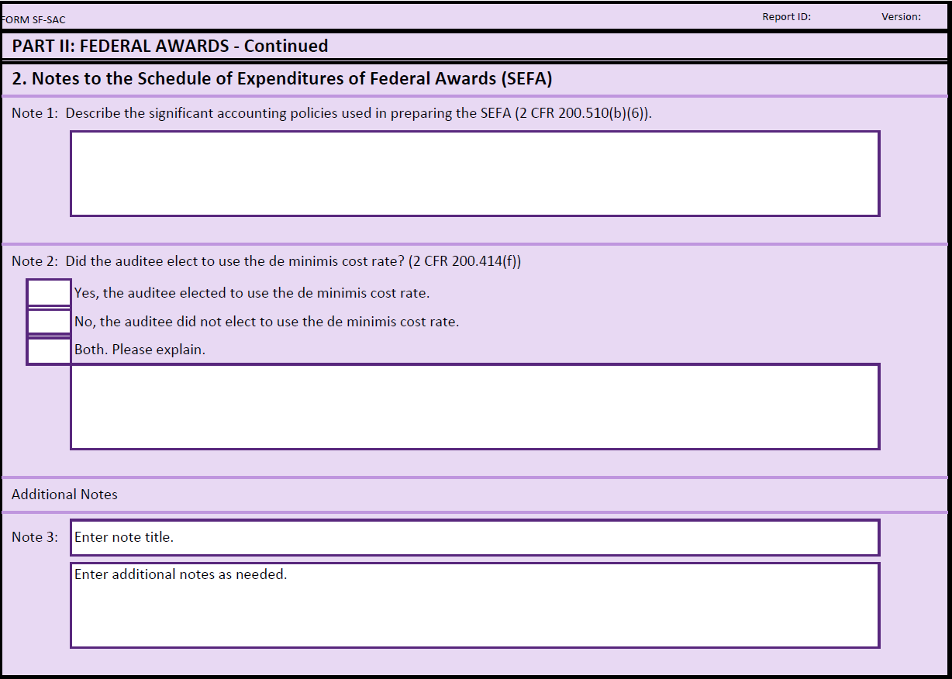
Draft 2019 SF-SAC: SEFA Notes

Slide 50
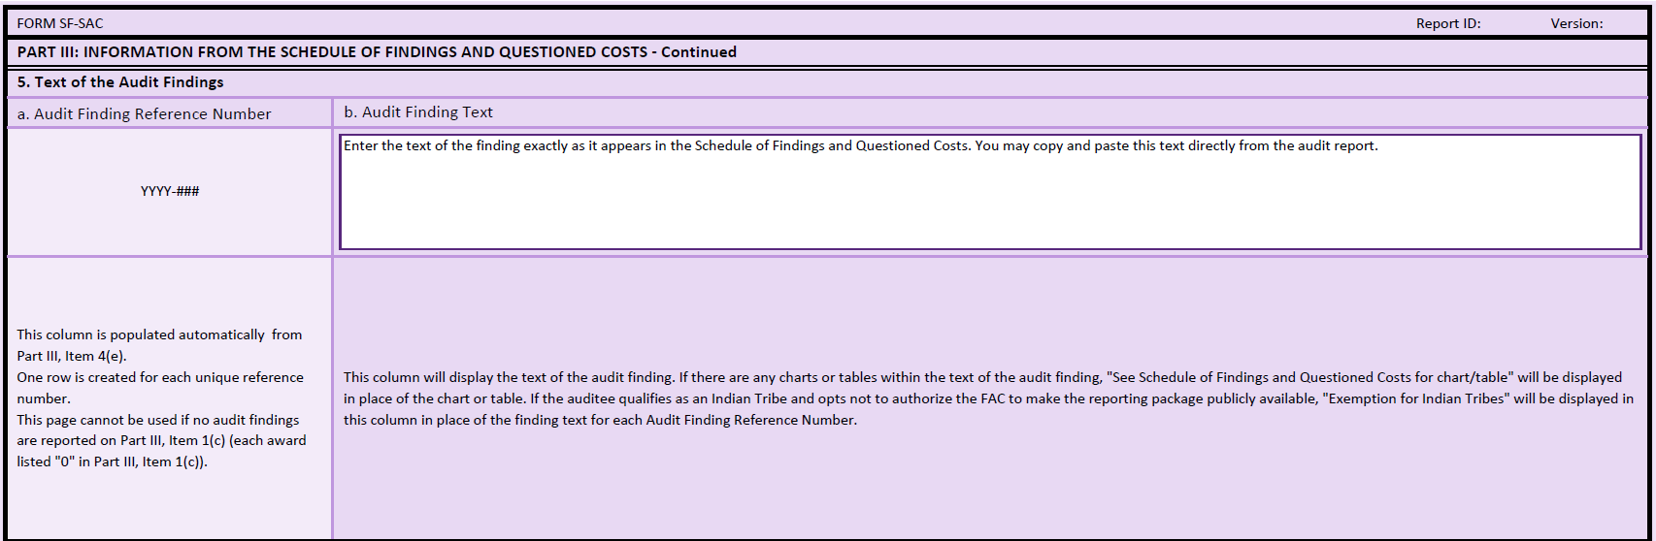
Draft 2019 SF-SAC: Audit Findings

Slide 51
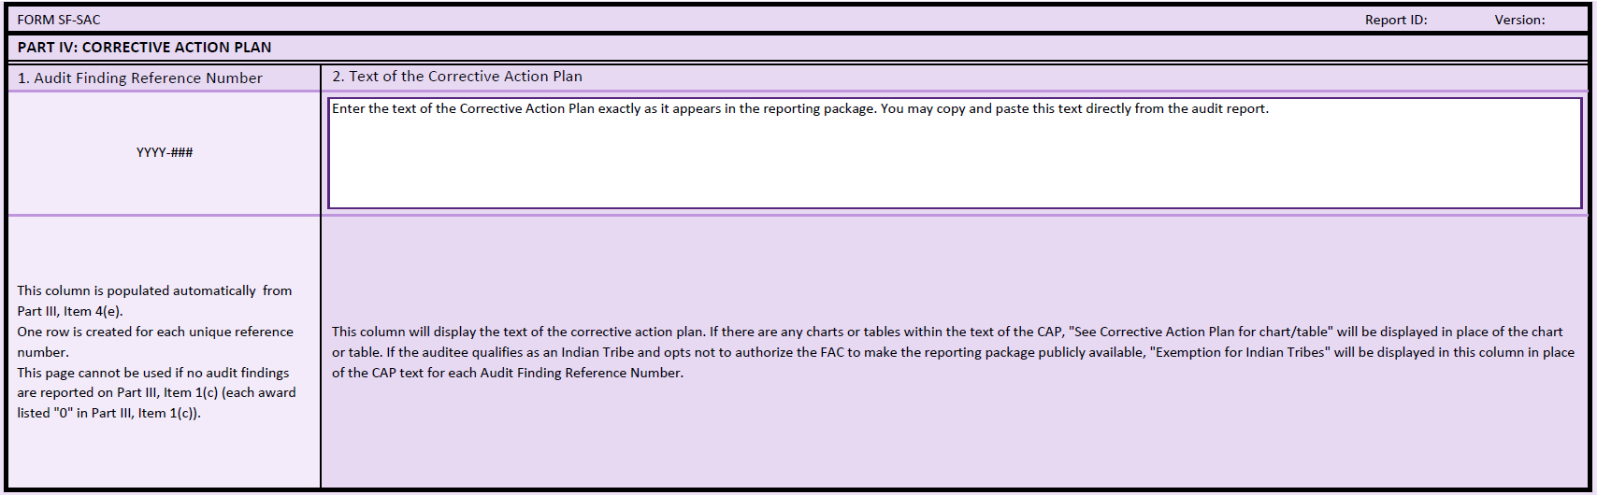
Draft 2019 SF-SAC: Corrective Action Plan

Slide 52
Draft 2019 SF-SAC (Data Collection Form) – November 2018
Revises existing data elements (not in the April 2018 release):
  Added a checkbox for each audit finding and corrective action plan (CAP) asking the user if there are any charts or tables that could not be copied or pasted to analyze how often this occurs
  Added a new yes/no question regarding whether the auditors communicated to the auditee, in a written document, any issues that were not audit findings (e.g., management letters)
Adds new data elements:
  Collect the date the auditor’s report(s) were received by the auditee
  Collect items that were modified when a revision has been conduced.

Slide 53
2019 Compliance Supplement
OMB is considering some interesting concepts:
  20 percent of agency programs are being examined for scrubbing and streamlining
  Compliance review areas limited to 6 compliance areas
    All 12 compliance areas remain applicable
    Program specific
    Rotate on a year to year basis
  Timing:
    Vett Draft in December 2018
    Final in February 2019

Slide 54
Transparency Issues
FFATA, DATA, GREAT Act

Slide 55
Increasing Transparency: The Continuing Story
FFATA (2006)
  Ongoing monthly reporting of federal awards and contracts at prime/first-tier sub levels
DATA (2014)
  Amends FFATA
GREAT (2018)
  Proposed legislation to further DATA

Slide 56
DATA Act: Timeline/Deadlines
May 2015
  Establish data standards
May 2017
  Federal agencies must report spending data using data standards
August 2017
  OMB must report Section 5 pilot results
May 2018
  Federal agencies must post spending data in machine-readable formats

Slide 57
Strategies to Reduce Grant Recipient Reporting Burden
OMB M-18-24
  Released September 5, 2018
  DATA Act required OMB to provide guidance to Federal agencies to implement lessons learned from Section 5 pilot
  Applies to all CFO Act agencies
  Intended to align with the results of the pilot and other agency grant-related reform initiatives with the President’s Management Agenda (PMA)

Slide 58
Strategies to Reduce Grant Recipient Reporting Burden
Among the requirements:
  Use government-wide data standards to modify existing or design new grant systems
  Work with other agencies and OMB to reduce the number of existing legacy systems and grant recipient burden via sharing quality services and systems
  Assess existing grant making policies to identify unnecessary or duplicate data collection or reporting requirements

Slide 59
Strategies to Reduce Grant Recipient Reporting Burden
Centralized Certifications and Representations
  Effective January 1, 2019, the SF-424B will become optional and agencies shall make plans to phase out its use in Funding Opportunity Announcements
  Effective January 1, 2020, SAM will become the central repository
    Registration in SAM is required annually
    Agencies will use SAM information to comply with award requirements and avoid increased burden and costs of separate requests

Slide 60
Strategies to Reduce Grant Recipient Reporting Burden
Agency Evaluation of Recipient Data
  By April 30, 2019:
    Each agency must evaluate all systems and other methods currently used to collect info from grant recipients and determine if the same data is being collected by the agency multiple times
    Use information from this review to construct a strategy (in conjunction with the objectives of CAP Goal #8) to eliminate duplicative requests with the agency.

Slide 61
GREAT Act
The Grant Reporting Efficiency and Agreements Transparency (GREAT) Act
  Continuation of the vision of the DATA Act
  Requires data structure (taxonomy) to cover all the data elements required of recipients of federal funds

Slide 62
GREAT Act
Legislative Update
  House (H.R. 4887)
    Introduced January 29, 2018
    Passed House on September 26, 2018
  Senate (S. 3484, the companion bill)
    Introduced on September 24, 2018
    Passed out of Committee on Homeland Security and Government Affairs by voice vote on September 26, 2018

Slide 63
GREAT Act
House and Senate bills have same requirements:
  Establish government-wide data standards for information related to federal awards reported by recipients of federal awards (within 1 year).
  Issue guidance to grantmaking agencies on how to utilize new technologies and implement new data standards into existing reporting practices with minimum disruption (within 2 years).
  Amends the Single Audit Act to provide for grantee audits to be reported in an electronic format consistent with the data standards (guidance to be issued within 2 years)

Slide 64
Accounting Issues

Slide 65
GASB’s Current Projects – The “Big Three”
In 2018, the GASB is working on three related efforts that will help reshape state and local governmental accounting and financial reporting
  The financial reporting model reexamination
  Revenue and expense recognition, and
  Research reexamining most existing note disclosure

Slide 66
GASB’s Reexamination of the Reporting Model: Governmental Funds
ITC introduces three alternative recognition approaches for governmental fund financial statements:
  Near-term financial resources
  Short-term financial resources, and
  Long-term financial resources
These three approaches fall on a continuum—from a closer-to-cash approach at one end to a closer-to-economic resources approach on the other

Slide 67
GASB’s Reexamination of the Reporting Model
Second phase of the project
Two Preliminary Views (PV) documents released on September 28, 2018:
  Financial Reporting Model Improvements
  Recognition of Elements of Financial Statements
    A separate, related document that proposes new concepts intended to guide the Board in developing standards on recognition
Comments due by February 15, 2019

Slide 68
Financial Reporting Model Improvements PV
Proposed changes:
  A short-term financial resources measurement focus for governmental funds that recognizes short-term transactions and other events when incurred and long-term transactions and other events when due
  A format for governmental fund financial statements that distinguishes between current and long-term resource flows
  Clarified explanations of operating and nonoperating revenues and expenses

Slide 69
Recognition of Elements of Financial Statements
Recognition concepts encompass two aspects of state and local government financial statements:
  The measurement focus of a specific financial statement determines what items should be reported.
  The related basis of accounting determines when those items should be reported.

Slide 70
GASB’s Reexamination of the Reporting Model – What’s Next?
Items that will be included in the Exposure Draft:
  Management’s Discussion and Analysis
    Consider alternatives for enhancing financial statement analysis, eliminating boilerplate components that are no longer necessary for understanding the financial reporting model, and
    Clarify guidance for presenting currently known facts, decisions, or conditions that are expected to have a significant effect.
  Debt Service Fund Presentation
    Consider alternatives for providing additional information about debt service funds (either individually or in aggregate).
  Extraordinary and Special Items
    Consider alternatives to improve the consistency of application of the guidance for reporting extraordinary and special items.
  Other Issues
    Consider alternatives that could permit more timely financial reporting or that could reduce complexity overall.

Slide 71
GASB’s Reexamination of the Reporting Model – What’s Next?
Timing
  Deliberations begin in October 2015
  December 2016: Invitation to Comment
  September 2018: Preliminary Views
  April 2020: Exposure Draft
  November 2021: Final Statement
  Implementation dates: sometime in 2022, 2023

Slide 72
Auditing Issues

Slide 73
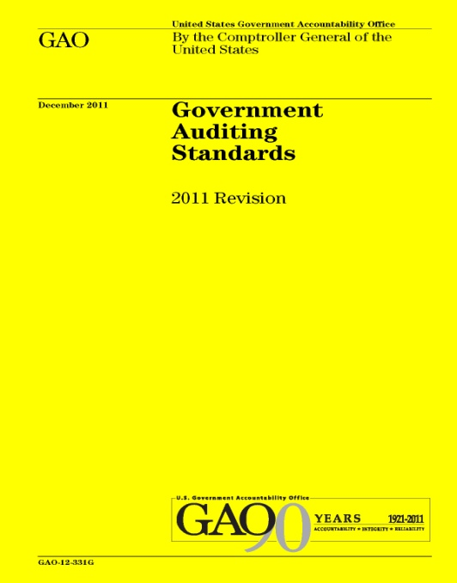
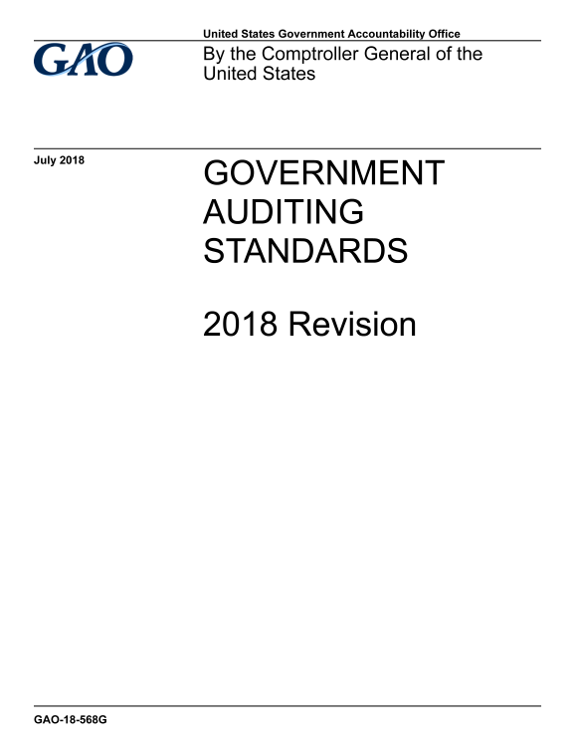
Update on the Developments in Government Auditing Standards
2018 Government Auditing Standards Revision (aka, Yellow Book or GAGAS)
Exposure Draft was issued on April 5, 2017
  95 comment letters with over 1,700 individual comments received
Final version issued July 17, 2018
  First revision since 2011

Slide 74
Summary of Key Changes from 2011 Revision
New format and organization
Common terms and definitions
Independence threats related to preparing financial statements
Updates to independence guidance
Competence of auditors
Guidance for CPE requirements
Competence of specialists
Peer review requirements

Slide 75
Summary of Key Changes from 2011 Revision
Quality control and monitoring of quality
Internal control: financial audits and examination engagements
Internal control: performance audits
New considerations for addressing waste
Standards for reviews of financial statements
Criteria for performance audits
Management assertions

Slide 76
Independence Threats Related to Preparing Financial Statements & Accounting Records
Nonaudit services performed by auditors related to financial statements and accounting records either:
Impair Independence
  No change from 2011 Yellow Book (para. 3.87)
  The auditor prepares financial statements in their entirety (para. 3.88).
  OR
  The auditor determines that a service related to preparing financial statements or accounting records is a significant threat (para. 3.93).
  Document the threats and safeguards applied to eliminate and reduce threats to an acceptable level (para. 3.33).
  OR
  Decline to perform the service (para. 3.88).
Are Significant Threats
Are Threats
  Evaluate threat and document evaluation (para. 3.90).
  Typing, formatting, printing, binding: not likely significant (para. 3.95)

Slide 77
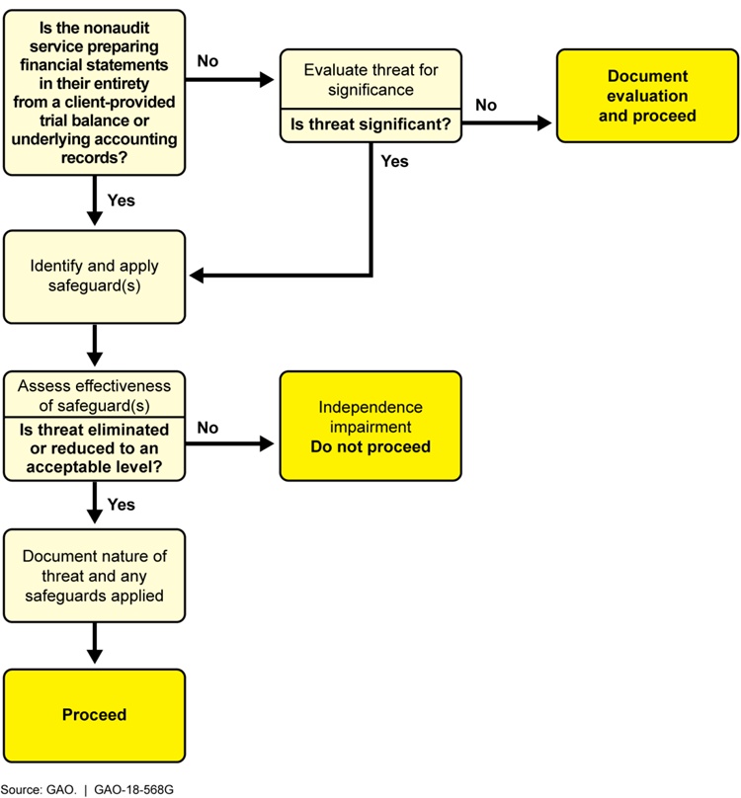
Independence Considerations for Preparing Accounting Records & Financial Statements

Slide 78
Additional Updates to Independence Guidance
Added application guidance to define management's “Skills, Knowledge and Experience” (SKE) an indicator is management’s ability to recognize a material error (para. 3.79).
Updated application guidance to clarify that certain services provided by government audit organizations would generally not create threats to independence allowability of certain functions such as investigations (para. 3.72).

Slide 79
Waste and Abuse
Auditor considerations related to waste and abuse are intended to be consistent
Auditors are not required to perform procedures to detect waste or abuse
Evaluating internal control in a government environment may include consideration of internal control deficiencies that result in waste or abuse
(paras. 6.20, 7.22, & 8.119)

Slide 80
Effective Date
2018 Revision is effective for
  - Financial audits, attestation engagements, and reviews of financial statements for periods ending on or after June 30, 2020, and
  - Performance audits beginning on or after July 1, 2019
Early implementation is not permitted

Slide 81
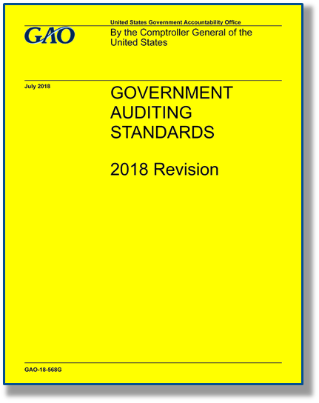
Where to Find the Yellow Book
The Yellow Book is available on GAO’s website at:
www.gao.gov/yellowbook
For technical assistance, contact us at:
yellowbook@gao.gov
or call (202) 512-9535

Slide 82
AICPA – Current Exposure Drafts
Three issued in November 2017:
  Auditor Reporting
    Proposes four new SASs
    Also includes proposed amendments Addressing Disclosures in the Audit of Financial Statements
    297 pages!
  Auditor’s Responsibilities Relating to Other Information in Annual Reports
  Omnibus Statement 2018
Comments due May 15, 2018

Slide 83
Auditor Reporting
Key changes:
  Moving the opinion to the first paragraph
  Adding an affirmative statement about the auditor’s independence and compliance with ethical responsibilities
  New Section
    AU-C 701, Communicating Key Audit Matters in the Independent Auditor’s Report
    Required for issuers (of securities); however, might be required by nonissuers if required by law, regulation, or contractual agreement (e.g., included in the terms of the audit engagement)

Slide 84
Auditor Reporting
Key Audit Matters
  Those matters that, in the auditor’s professional judgment, were of most significance in the audit of the financial statements of the current period
  Key audit matters are selected from matters communicated with those charged with governance

Slide 85
AICPA Proposed SSAE: Clarification and Recodification
Exposure draft issued July 11, 2018
  Comments due October 11, 2018
Among the most significant changes:
  For all attestation engagements
    No longer requires the practitioner to request a written assertion from the responsible party when reporting directly on the subject matter
    Adds a statement to the practitioner’s report regarding independence
  For AT-C section 210 (review engagements)
    More closely harmonize with the limited assurance provisions of International Standard on Assurance Engagements 3000, including changing the term “review” to “limited assurance”
    Require the report to include an informative summary of the work performed as a basis for the practitioner’s conclusion

Slide 86
AICPA Proposed SSAE: Clarification and Recodification
Among the most significant changes (cont.):
  For AT-C section 215 (agreed-upon procedures)
    No longer require that all of the parties to the engagement (the engaging party, the responsible party and users of the practitioner’s report) agree to the procedures to be performed and take responsibility for their sufficiency
    Instead the engaging party acknowledges in writing the appropriateness of the procedures and would explicitly allow the practitioner to develop, or assist in developing, the procedures
    Expanded to incorporate Selected Procedures engagements
    Allow the practitioner to issue a general use report (unless certain limitations apply)

Slide 87
AICPA Professional Ethics Division: State and Local Government Entities
Exposure Draft issued July 7, 2017
  Formerly Entities Included in State and Local Government Financial Statements (ET sec. 1.224.020)
  Addresses a member’s (of the AICPA) independence with respect to entities that are required to be included in a state or local government’s financial reporting entity
Final expected in late 2018
  PEEC decided at November 2018 meeting to re-expose for 60 days to address questions about overall clarity
    Expected to be released in December 2018

Slide 88
AICPA Professional Ethics Division: State and Local Government Entities
Makes use of terms downstream, upstream and brother-sister entities
  Downstream: refers to those entities that are “below” the f/s attest client in its organization structure
    e.g., financial statement attest client is the primary government, funds and component units to be evaluated are those required to be included in the primary government’s financial reporting entity
  Upstream: refers to those entities that are “above” the f/s attest client
    e.g., financial statement attest client is a fund or component unit
  Brother-sister: refers to other funds and component units that the member does not provide attest services to but are included in the same upstream financial reporting entity as the financial statement attest client

Slide 89
Other Emerging Issues
Things on the radar…

Slide 90
XBRL Developments: State and Local Governments
XBRL US has formed a state and local government workgroup
  Developing a taxonomy for a CAFR
Florida HB 1073
  Authorizes the creation of Florida Open Financial Statement System
    An interactive data repository for government financial statements
    Requires the Florida CFO to determine whether a suitable XBRL taxonomy has been developed.
    Effective for FY ending on or after September 1, 2022
Will other states follow?

Slide 91
These continue to be interesting times…

Slide 92
Questions or Comments?
R. Kinney Poynter, CPA
NASACT
kpoynter@nasact.org
(859) 276-1147

