Slide 1


Slide 2
Big Data Analysis in Public Sector – CarLab research
Miklos A. Vasarhelyi
KPMG Distinguished Professor of AIS,
Rutgers, the State University of New Jersey
Director of CarLab
November 29, 2018

Slide 3
THE CARLAB (CONTINUOUS AUDIT AND REPORTING LABORATORY)
RUTGERS BUSINESS SCHOOL

Slide 4
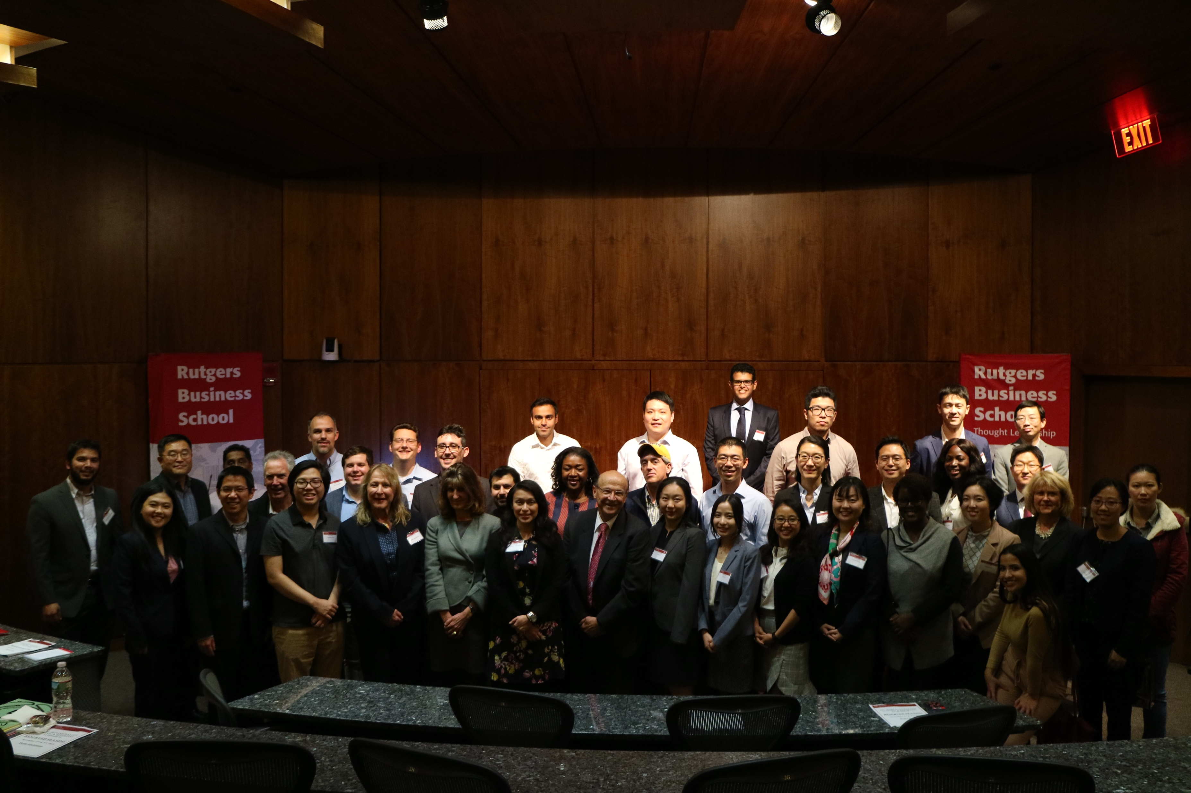

Slide 5
CarLab
CarLab Analytic Research
Choosing apps
Predictive Analytics with Weather data
Audit data analytics and EDA
Envisaging the future of audit and Big Data
Text Mining
Monitoring
Unibanco’s
branches
Visualization
Process Mining at Gamma Bank
Expert System for P-Card
Logit regression for control risk assessment
Exceptional Exceptions
Client
Retention
Project
Litigation
prediction
Fraud Risk Assessment using EDA
Detecting duplicate records
Continuity equations
Predictive Audit
Credit card
Default
prediction
Continuity Equations at HCA
XBRL
Insurance
Analytics
Multidimensional clustering for fraud detection
Rule-based selection for transitory accounts
XBRL
Insurance
Analytics
Cognitive
Decision Aids
AI: Deep Learning
Robotic Process Automation (RPA)
Intelligent Process Automation (RPA)
Blockchain and Smart contracts
Cluster Analysis of US States

Slide 6
CarLab Analytic Research in Public Sector
NYC Street Cleanliness and on-street Parking | IPSASB - XBRL | SICONFI
Brazilian Navy | Brazil Health System Acquisition – Rio de Janeiro Municipality | Securities and Exchange Commission of Brazil (CVM)
PCAOB - Webcast | NPO Form990 Database | Rutgers Internal Audit
Audit with Blockchain & Smart Contracts on the Government Sector | Open Government Financial Data | XBRL reporting for U.S. local governments

Slide 7
BRIGHAM YOUNG UNIVERSITY
The Ranking of Rutgers in the Accounting Areas 2017
Areas | Ranking 2011-2017 | Ranking 2005-2017 | Ranking 1990-2017
AIS | #1 out of 150 | #1 | #1
Audit | #9 out of 355 | #6 out of 370 | #14
Financial | #61 out of 397 | #76 out of 406 | #78
Managerial | #116 out of 300 | #85 | #74
Tax | #69 out of 129 | #57 | #71
Other | #21 | #40 | #23

Slide 8

Jimmy Chin
Skiing down the
Everest

Slide 9
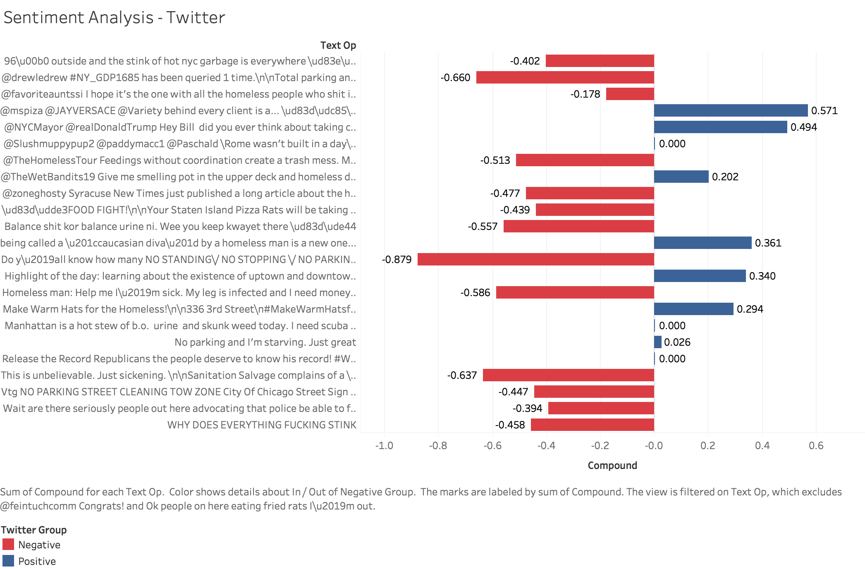
NYC Street Cleanliness and on-street Parking
Apply text mining techniques to social media ‘big data’, perform sentiment analysis to NYC street cleanliness and on-street parking
Collected Period: 9/26/2013 – 9/26/2018

Slide 10
NYC Street Cleanliness and on-street Parking
Examined 311 Service Request List to evaluate Twitter data
Total 594,330 complaints, the top 5 categories are:
Complaint Type | Number of Complaints
Request Large Bulky Item Collection | 179,867
Rodent | 150,054
Graffiti | 79,435
Food Establishment | 48,171
Electronics Waste | 30,664

Slide 11


Slide 12
IPSASB - XBRL
Comment Letter: Proposed International Public Sector Accounting Standards Strategy
  Suggested IPSASB to use XBRL
What is XBRL?
  global standard developed to enhance transparency and accountability in business performance globally by providing the open data exchange standard for business reporting.
Conclusion:
  Maximized informational value when federal governments are able to report tagged for comparison
  Better international relations to support billions of citizens world-wide through XBRL

Slide 13
Brazilian Projects
TEXT MINING
  Brazilian SEC - CVM – Comissão de Valores Imobiliários
CONTINUOUS AUDIT
  State of Santa Catarina
  Brazil Navy
  Brazil Health System Acquisition – Rio de Janeiro Municipality
Data Quality and XBRL
  Siconfi – Sistemas de Informações Contábeis e Fiscais do Setor Público do Brasil

Slide 14
PCAOB - Audit Data Analytics Webinars
PCAOB Audit Data Analytics Webinars:
Design and instruct Audit Data Analytics online lectures for the Public Company Accounting Oversight Board (PCAOB) on the application of data analytics to the audit process.
Some topics covered thus far:
Introduction to audit data analytics concepts
Applying audit data analytics through the audit
Continuous Auditing and Monitoring
Overview of Big Data
Demonstration of Predictive Analytics with Exogenous Data
Audit Data Standards and Robotic Process Automation

Slide 15

Design of a SmartCMS to develop Internal Control Intelligence
Jiahua Zhou, Hussein Issa, Helen Brown-Liburd

Slide 16

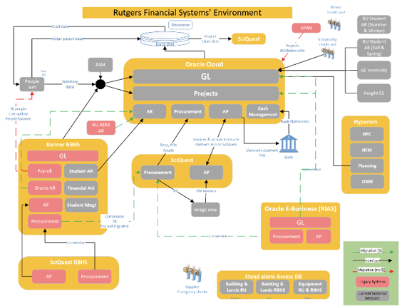
Real-time assurance, continuous auditing, and audit by exception.
Different approach for P2P Audit: faster and more effective audits with
  Easy-to-use data analytics tool
  Analyzing 100% of the population (e.g. Invoices with purchases)
Different approach to
  Confirm sufficient data access
  Develop a data analysis tool particularly suitable for P2P Audit

Slide 17
Audit with Blockchain & Smart Contracts on the Government Sector

Slide 18
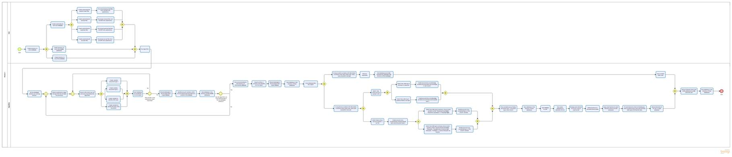
Watching the Watchdog

Slide 19
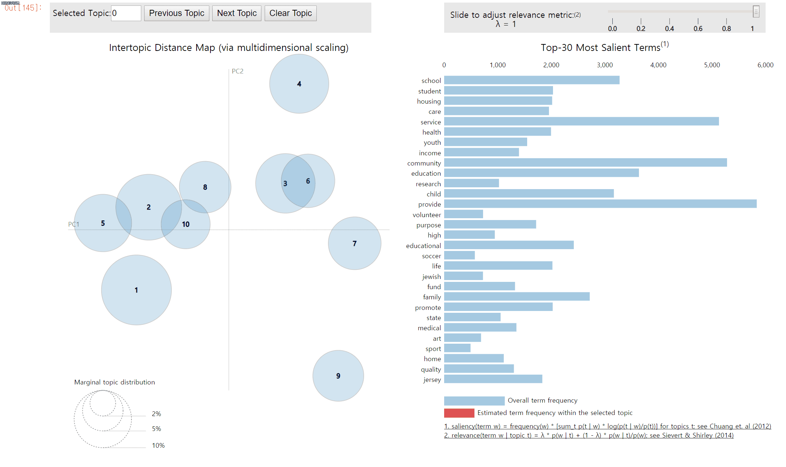
NPO Form990 Database – New Jersey
Using LDA to categorized the type of NPO based on mission statements.
Notes:
E-filling form 990 and form 990 ez data contained financial, organizational and legislation information about the NPO. We have the data from 2011 to 2016. This is a potential research project. We are working on the analyzing all the NPOs in New Jersey, there are 6822 NPO organizations and 21989 record of form990. By apply LDA technique, which is a generative statistical model that using in natural language processing. We find the clusters of the organization mission.

Slide 20
Rutgers Accounting Digital Library

Slide 21
Thank you

