Slide 1
Developing a Teaching Portfolio
3rd Online Doctoral Workshop on Supply Chain Analytics

Slide 2
Agenda
Introducing the Panelists
The customers – programs, audience
The process – formats, content
Criteria for success
Analytics Applications

Slide 3
Ananth Iyer
Krannert School of Management at Purdue University - Susan Bulkeley Butler Chair in Operations Management; currently Department Head, Senior Associate Dean at Krannert; Director, Dauch Center for the Management of Manufacturing Enterprises.
Effective August 1, 2022 - Dean of the School of Management, University at Buffalo
Teaching/Research Interests: Analysis of supply chains in the areas of spare parts, auto components, the grocery industry, rare earth metals, retail and the fashion apparel industry.
PhD (ISE) – Georgia Tech; MS (IE&OR) - Syracuse University; B Tech (MechEng) - IIT Bombay.

Slide 4
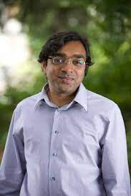
Apurva Jain
Foster School of Business, University of Washington - Professor - Department of ISOM
Teaches core Operations, Process Improvement, and Inventory & Supply Chain undergraduate, graduate, and executive programs.
2021 Best Teacher award, SCM graduate program
Consulting supported an anti-trust action directed at Sold-by-Amazon program.
Research focus is developing applications of continuous-time stochastic models to pandemic decision-making, community solar programs, and buzz-driven demand spikes.

Slide 5
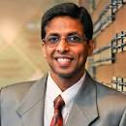
Subodha Kumar
Fox School of Business, Temple University - Paul R. Anderson Distinguished Chair Professor of Statistics, Operations, and Data Science; Founding Director of the Center for Business Analytics and Disruptive Technologies; Concentration Director for Ph.D. Program in Operations and Supply Chain Management.
Changjiang Scholars Chair Professorship, Ministry of Education, China
Fellow, POMS; Ranked #1 worldwide for publishing in Information Systems Research.
Deputy Editor of Production and Operations Management Journal; Founding Executive Editor of Management and Business Review (MBR).

Slide 6
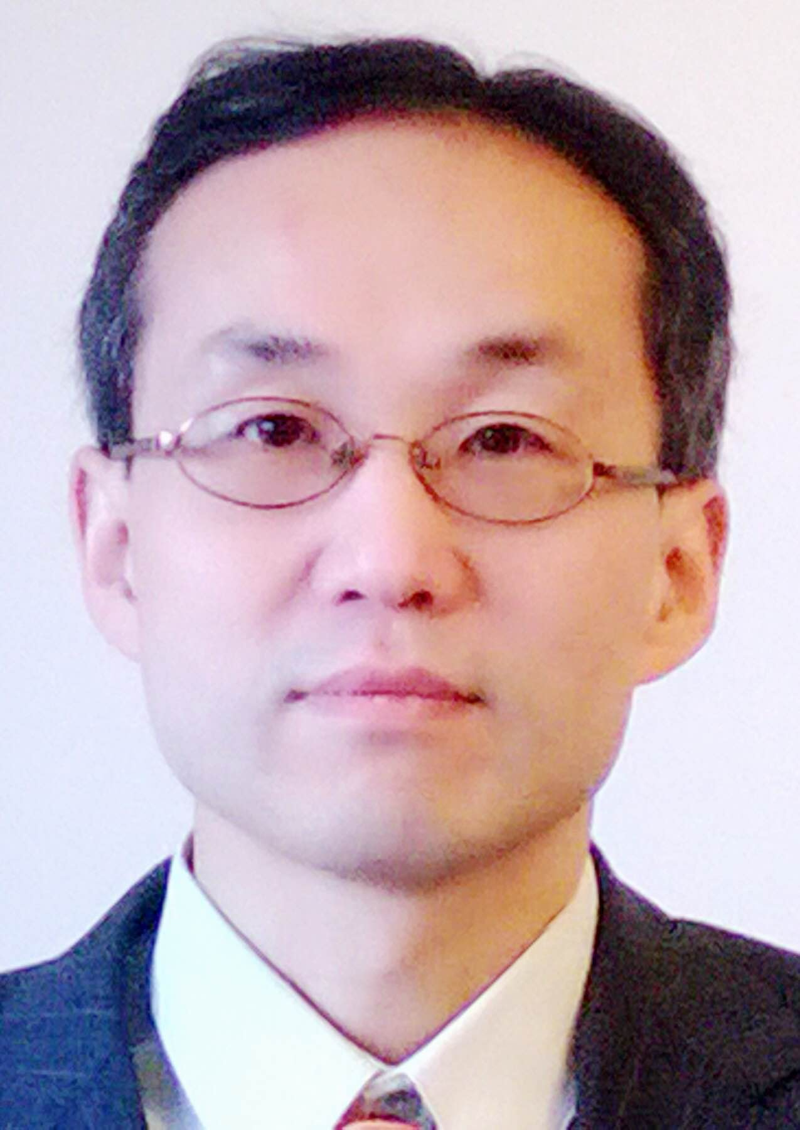
Yao Zhao
Rutgers Business School, Rutgers University - Professor
Research Interests - supply chain management with a special focus on design, control and coordination of stochastic production-inventory systems, integration of supply chain management with project management, and applications in pharmaceutical industry.
Honorable Mention of the 2001 student paper competition – M&SOM; Recipient of the 2008 National Science Foundation (NSF) CAREER Award.
Teaches core operations management and supply chain management courses for undergraduate, MBA, executive and PhD programs at Rutgers Business School.
Industry Collaborations - General Motors in the area of Spare Part Operations; Estee Lauder Companies Inc. in the areas of forecasting and inventory control for new product introduction.

Slide 7
Asoo J. Vakharia (Moderator)
Warrington College of Business, University of Florida – McClatchy Professor; and Director, Supply Chain Management Center
Fellow, POMS and DSI.
Current research focuses on sustainability, IOT, and 3-D printing.
Teaching interests are in O&SCM; Operations Strategy, International Logistics; Graduate and Executive Teaching at UF; Industry specific teaching in Managerial Decision Analysis, Quality Analysis/Statistical Methods, Operations/Financial Analysis, and Supply Chain Analytics.
Consulting/Collaborations: AT&T Solutions Customer Care, e-Diets.com, Golden Eagle Distributors, Garrett Air Research, Motorola, Sweetheart Cups, Inc., University of Arizona Medical Center, and Vistakon, Inc.

