Slide 1
Portfolio of programs
Jake Cohen
Senior Associate Dean, Degree Programs
Senior Lecturer, Accounting and Law

Slide 2
Ongoing focus
1
Build and strengthen each program and activity to reach its highest potential.
2
Identify and capture the synergy value from our portfolio-of-programs strategy.
3
Collaborate across MIT to capitalize on and contribute to the Institute’s distinctive intellectual excellence and global impact.
4
Communicate our unique value proposition to stakeholders.

Slide 3
PORTFOLIO OF PROGRAMS
Areas of Excellence
MANAGEMENT
FINANCE
ANALYTICS
Entrepreneurship, Innovation & Technology
Average Age
EMBA & SFMBA
40
.......
GRADUATE
MBA / LGO
27
...
MASTER OF
FINANCE
MASTER OF
BUSINESS ANALYTICS
23
..
UNDERGRADUATE
MAJOR & MINOR
MAJOR & MINOR
MAJOR & MINOR
20
Sloan Certificates: Open to all MIT students
Healthcare
Sustainability
Analytics

Slide 4
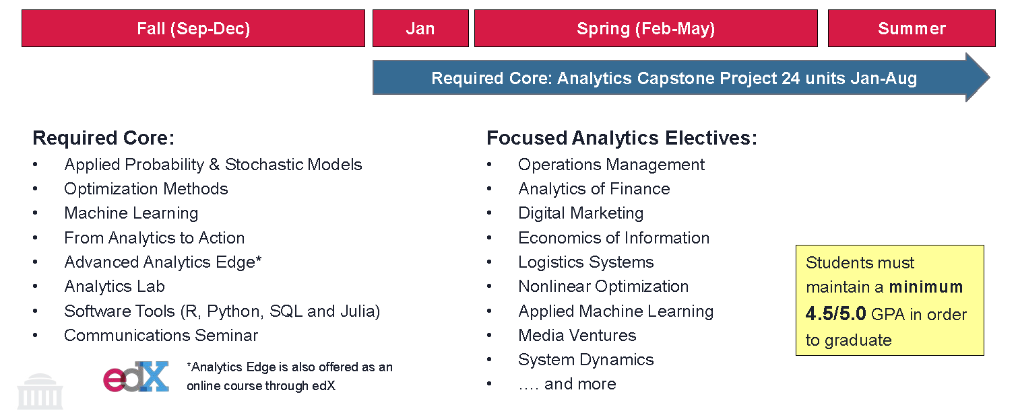
Master of business analytics

Slide 5
15-2 Business Analytics major
Required Subjects:
Communicating with Data
Computer Programming
Organizational Processes
Optimization
Probability
Statistics
Stochastic Models in Business Analysis
Machine Learning
Restricted Electives:
Students take five subjects from an approved list of subjects with analytics content or analytics focused. Examples include:
Game Theory for Strategic Advantage
Metrics of Managers: Big Data and Better Answers
Data Mining: Finding the Data and Models that Create Value
The Analytics Edge
Predictive Data Analytics and Statistical Modeling
Analytics of Finance
Financial Engineering
Notes:
List of about 20 electives to choose from for Restricted electives with subjects both in and not in Sloan.
Students can also petition to have other courses counted as restricted electives.

Slide 6
business analytics certificate
REQUIREMENTS
To obtain the certificate students must complete the 3 Core requirements, 2 electives and 1 Action Learning class with an analytics component.
PART 1: CORE REQUIREMENTS
Core requirement #1: Students must take one of the following:
The Analytics Edge
Analytics of Operations Management
Machine Learning
Core requirement #2:
Communicating with Data
Core requirement #3:
Analytics Proseminar
PART 2: ELECTIVES
Students must complete two courses, each from a different group listed below:
Marketing: 15.819, 15.570
Finance: 15.450, 15.460, 15.034, 15.S13, 15.S08, 15.458, 15.459
Operations Management: 15.761, 15.762/63, 15.764, 15.774, 15.777, 15.778, 15.784
Operations Research/Stat:15.062, 15.068, 15.093, 15.077, 15.071
System Dynamics: 15.872
BPS: 15.304, 15.669, 15.662, 15.S14
Economics: 15.034
A thesis or Independent Study focused on analytics can also qualify as an elective.
PART 3: ACTION LEARNING ELECTIVE WITH ANALYTICS CONTENT
Students must take one course from the list below:
Analytics Lab
Operations Lab (Project with analytics focus)
Healthcare Lab (Project with analytics focus)
Other Action Learning courses with a project focused on analytics can qualify as well.*
*For a project to qualify for the Certificate, it must involve building predictive (e.g. regression, classification models) or prescriptive (e.g. optimization, inventory models) models.

