Slide 1
Getting the right job!
Have a long-term vision/mission statement for your career
E.g., use math/science to make a profound impact on industrial decisions
Think about your personal preferences- but not too much
E.g., type of location (city versus rural), US/EU/Asia etc, being near family/partner’s job, etc.
What type of job are you open to? SCA research can be done in large companies, as well as engineering schools and business schools at universities
Industry: Amazon, IBM, Uber, Google, Facebook, Microsoft…
Once you’ve some criteria for applying, do make every application an impeccable one
Because your job market “tour” is one way to advertise your work broadly, and for senior people to get to know you
Good impressions last…and so do bad ones!
Don’t hold a grudge if you don’t get the job you dreamed of
Notes:
Please take 10 minutes to share your own experience and tips on this topic without taking questions. Please feel free to prepare a few slides if you wish (feel free to use your school logo to promote).

Slide 2
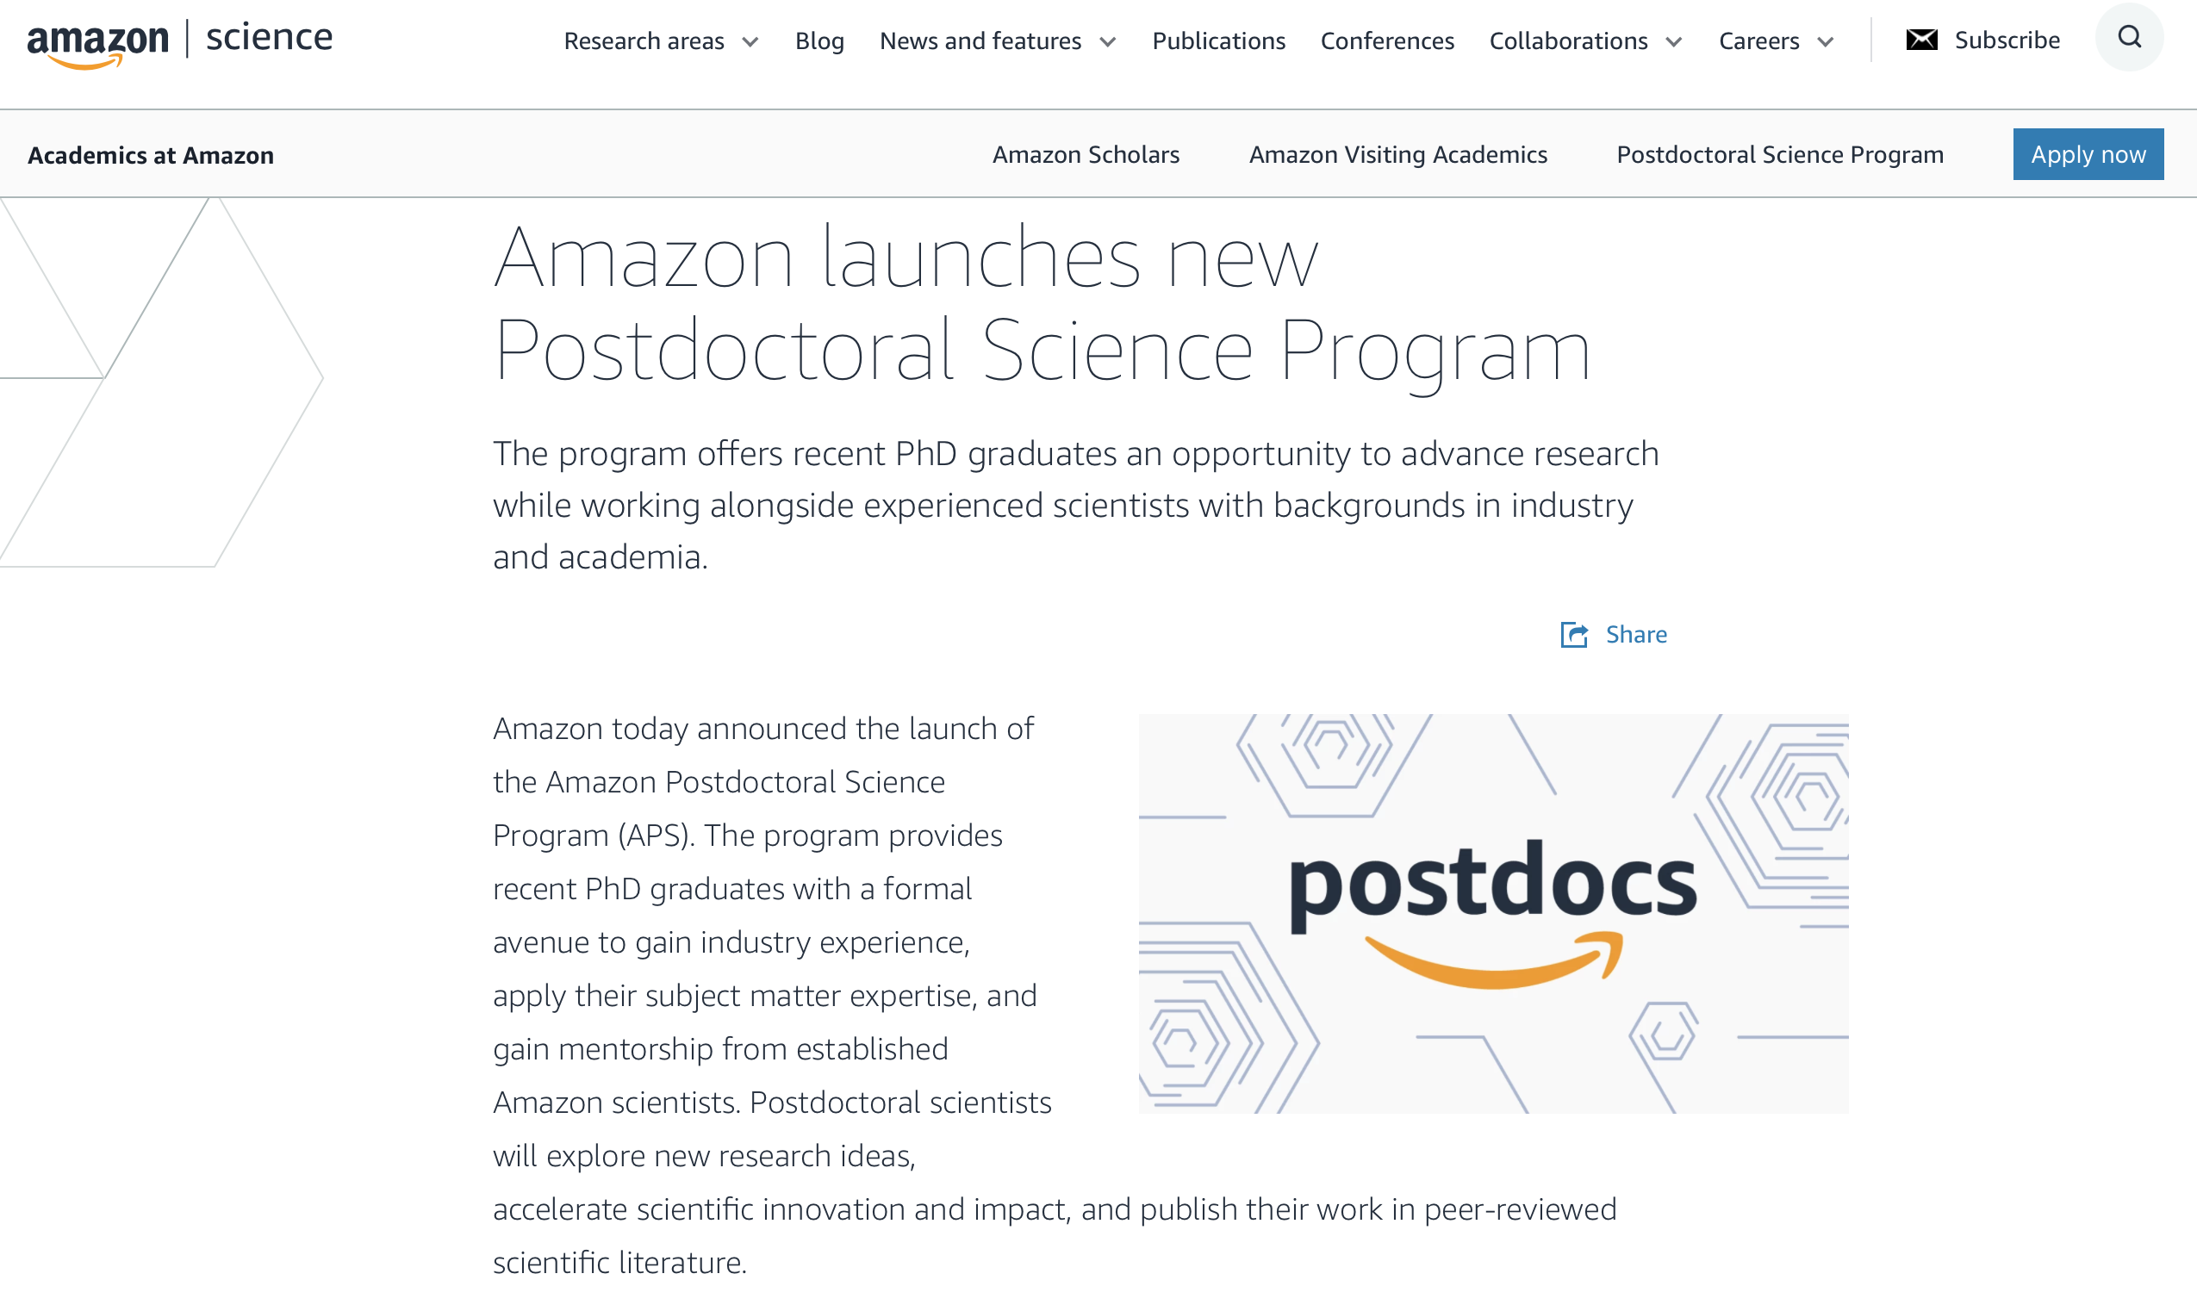
https://www.amazon.science/postdoctoral-science-program

